Slide 1

Tahrir Data Project
Preliminary Descriptive Analysis

Slide 2
Discursive Context
Pessimism and Utopianism
since Iran and Moldova
2011>Deen Freelon’s 4-part taxonomy
The Hype and the Blowback
Still an anecdotal debate
Still: «Was it a Facebook Revolution?»

Slide 3
The Tahrir Data Sets
TDS-a: protester media-use
  1200 interviews between Feb 24 & March 1
  In-depth, “superficial” questionnaire
TDS-b: coordinator media-use
  35 individuals, semi-structured, purposive sample
TDS-c: Twitter and transnational networks
  #jan25 tweets between Jan 21 & Feb 11
  675,715 tweets, 106,000 users, 27 languages

Slide 4
TDS-a: Protester Sample
“Hidden population”
Predominantly:
  young,
  well educated,
  non-politcally active,
  wired
  men

Slide 5
Frequencies:
media use

Slide 10


Slide 11
Logical Regressions:
Out on first day &
first time protesting

Slide 12
Protested on Day 1
 | Exp (b) | P
Age | 1.009 | 0.27
Male | 1.295 | 0.11
Education | 0.991 | 0.87
Net at Home | 1.297 | 0.21
Net on Phone | 1.091 | 0.54
Uses Text Gen | 1.092 | 0.56
Uses FB Gen | 1.443* | 0.01
Uses TW Gen | 1.429* | 0.05
Uses Blogs Gen | 1.197 | 0.4
Uses Email Gen | 0.818 | 0.31
Uses Phone Gen | 1.22 | 0.46
Uses TV Gen | 0.483** | 0.01
Uses Radio | 1.089 | 0.56
Uses Print | 1.366* | 0.04
_cons | 0.341* | 0.04
N | 1029
ll | -654.933
* p<0.05, ** p<0.01, *** p<0.001

Slide 13

Not 1st Protest
 | Exp (b) | P
Age | 1.034*** | 0
Male | 1.034 | 0.84
Education | 1.03 | 0.61
Net at Home | 1.589* | 0.03
Net on Phone | 1.118 | 0.44
Uses Text Gen | 1.227 | 0.19
Uses FB Gen | 1.349* | 0.04
Uses TW Gen | 1.467* | 0.04
Uses Blogs Gen | 0.961 | 0.86
Uses Email Gen | 1.11 | 0.61
Uses Phone Gen | 0.673 | 0.13
Uses TV Gen | 0.763 | 0.34
Uses Radio | 0.723* | 0.04
Uses Print | 1.781*** | 0
_cons | 0.099*** | 0
N | 1029
ll | -631.21
* p<0.05, ** p<0.01, *** p<0.001

Slide 14
Frequencies:
Media rankings and protester behaviour

Slide 15
Media Rankings (1)

Slide 16
Media Rankings (2)

Slide 19




Slide 20
Key Protest Metrics
Reliability
Documentation
Relay
Blogs
(>tw, live, fb, em)
Exaggeration for Blogs and TW in content types and motivations
Sources:
TV, Live, Phone, FB, Print
Users
FB, live TW, phone, sat
Facebook and TV strongest showers
Both as info types and activities
The strange showing of live communication

Slide 21
Implications of TDS-a
Digital distinguish themselves through:
Degreee and character of media use
Behavior of media users
User relationships to media

Slide 22
TDS-c: Tweeters
Power law distributions
for tweeters and retweeters.
Notes:
“a power law describes data in which the nth position has 1/nth of the first position’s rank. In a pure power law distribution, the gap between the first and second position is larger than the gap between second and third, and so on.”

Slide 23
TDS-c:
Transnational communication flows

Slide 24
TDS b: Coordinator Strategies
Traditional media & Hybridity
Strong ties and weak ties
Transnational Information Flows as
  Security
  Motivation
  Principle

Slide 25
Preliminary Conclusions
Digital media are distinct
Digital media vs hybrid media
Context and contingency
We need more sophisticated models
  Utopianism and pessimism do not suffice
  Information ecologies
  Functional network mappings

Slide 26
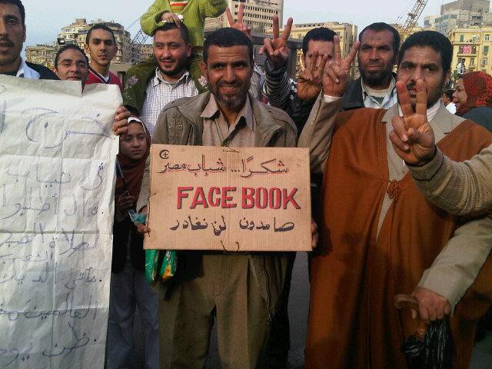
A Facebook Revolution?
Silly Question

Slide 27
Moving Ahead
Implications for further research
  Grounded research
  Local research
  Open research
  Comparative research
Objects for further research
  Mapping
  Relay
  Duplication and comparison

Slide 28
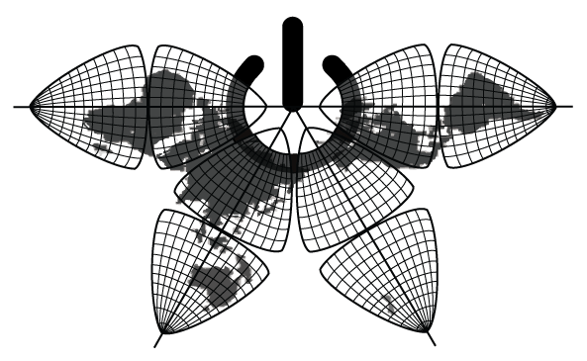
http://tahrirdata.info

